Slide 1
Deep Learning
Weight Initialization
Lec # 5

Slide 2
ANN
Initialize weights and bias
1
Choose an optimization algorithm(loss)
2
Repeat this process
3
Forward propagation
Compute cost & loss
Compute gradient using backpropagation
Update weights

Slide 3
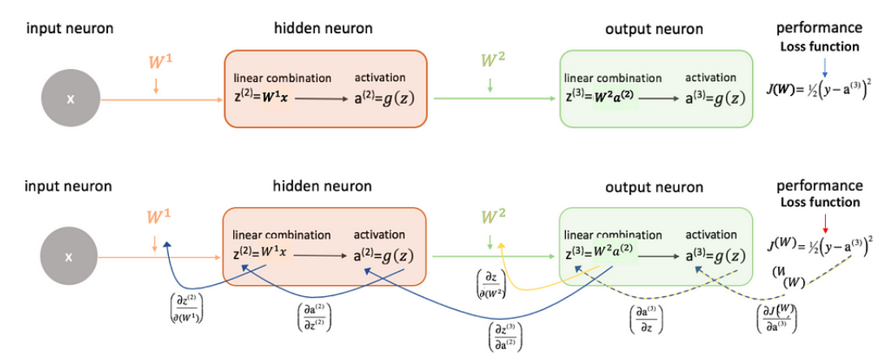

Slide 4
Why weight Initialization is Important?
Main objective
to prevent layer activation outputs from exploding or vanishing gradients during the forward propagation.
If either of the problems occurs, loss gradients will either be too large or too small, and the network will take more time to converge
If we initialized the weights correctly, then our objective i.e., optimization of loss function will be achieved in the least time otherwise converging to a minimum using gradient descent will be impossible.

Slide 5
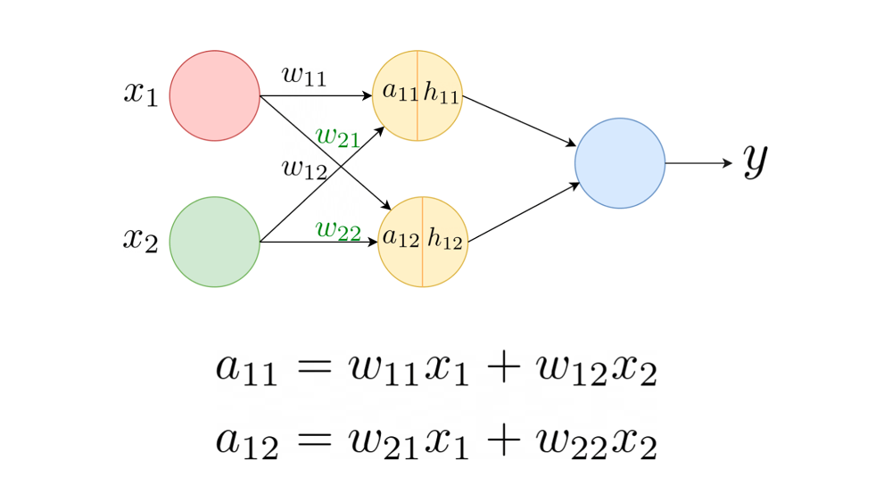
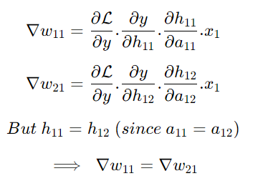
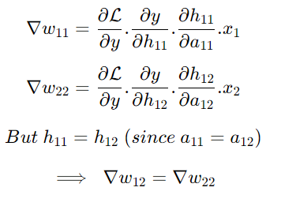
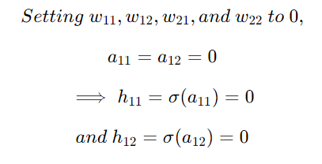
Zero Initialization
Relu and tanh : no learning
Sigmoid : behave like one neuron,
non-linearity can’t capture
Relu = max(0,z)
Sigmoid = [0 to1]
Tanh = [-1 to 1]
sigmoid
Relu and Tanh
0.5
0.5

Slide 6
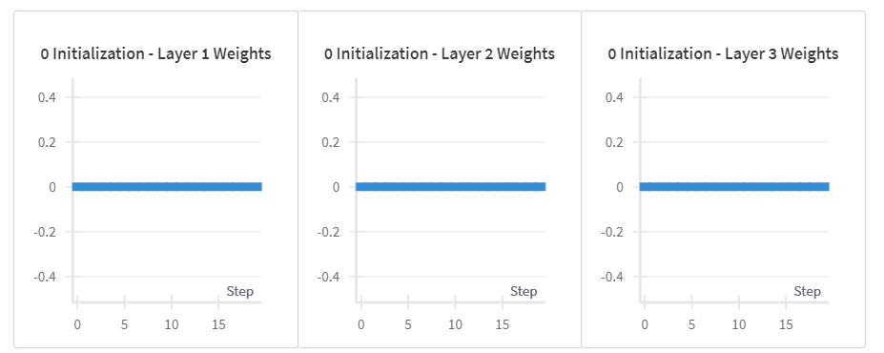


Slide 7
constant Initialization
Relu ,tanh and Sigmoid :
behave like one neuron,
non-linearity can’t capture
Relu = max(0,z)
Sigmoid = [0 to1]
Tanh = [-1 to 1]
sigmoid
Relu and Tanh

Slide 8

Random Initialization
Initializing the Weights to Small Random Values
1
Initializing the Weights to large Random Values
2

Slide 9
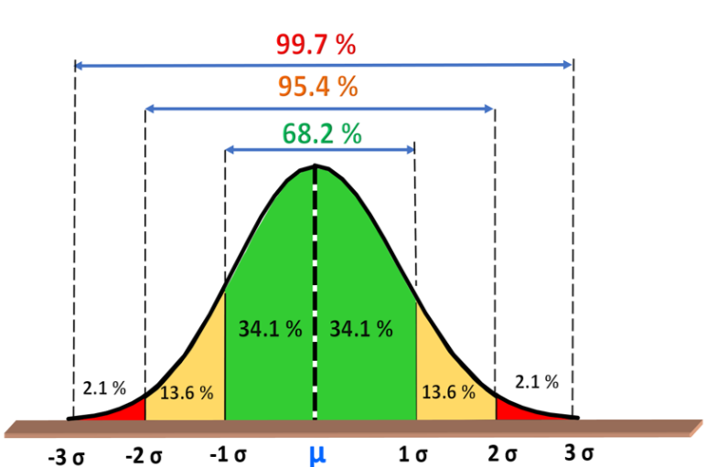
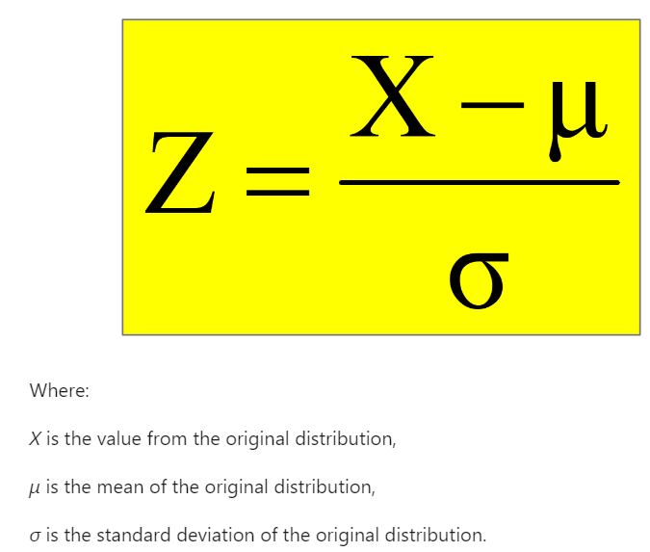
Initializing the Weights to Small Random Values
random uniform distribution in range [0, 1], or better, [-0.5, 0.5]
Gaussian distribution(Normal Distribution) with mean 0 and small variance (e.g., 0.1 or 0.01)
If weights are initialized with low values it gets mapped to 0

Slide 10
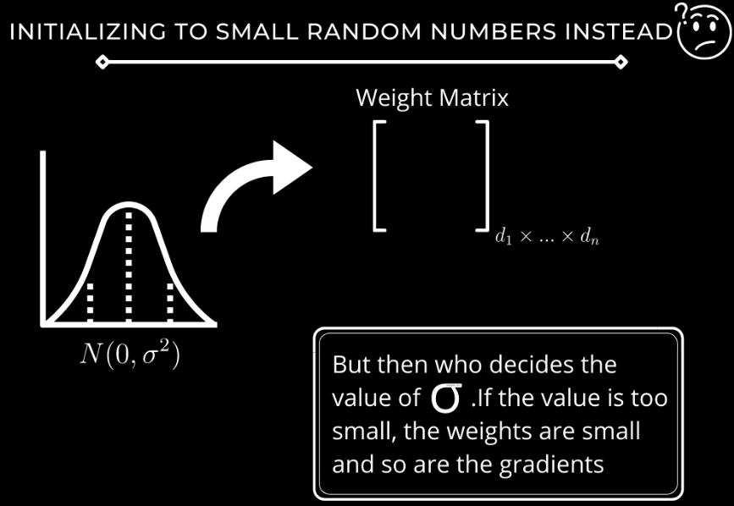
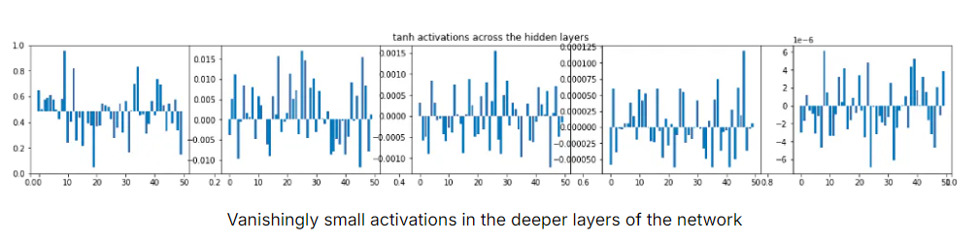
When the magnitude of activations is small, the gradients are vanishingly small, and the neurons do not learn anything!

Slide 11
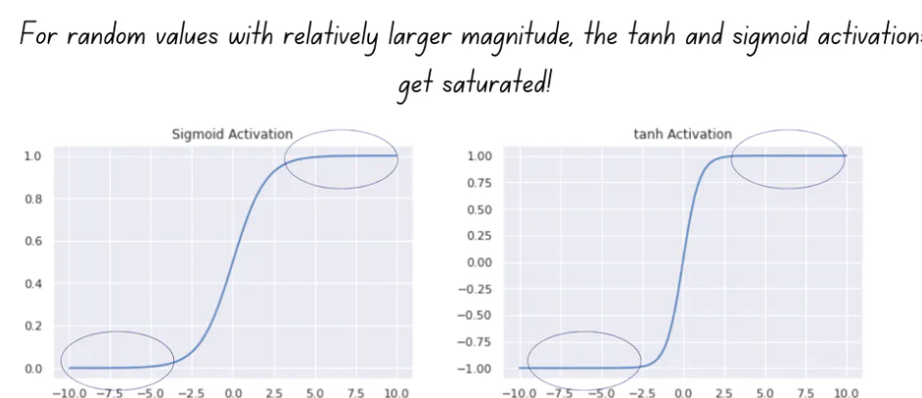
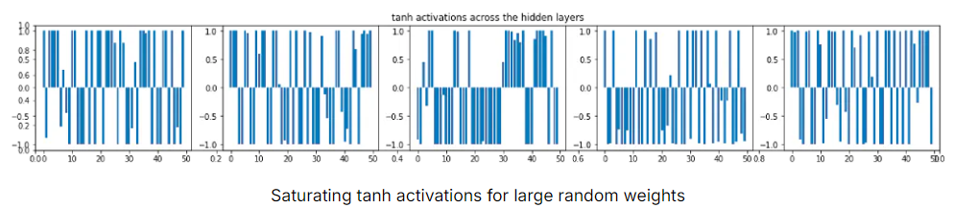
Initializing the Weights to Large Random Values
When the weights have a large magnitude, the sigmoid and tanh activation functions take on values very close to saturation.
When the activations become saturated, the gradients move close to zero during backpropagation. (vanishing Gradient)
In case of Relu, A too-large initialization leads to exploding gradients. This leads the cost to oscillate around its minimum value.

Slide 12
Summary of random weights
In the first case, we sampled the initial weights from a standard normal distribution with zero mean and unit variance and scaled them by a factor of 0.01.
This is equivalent to drawing samples from a standard normal distribution with zero mean and variance 0.01², which is negligibly small.
When the weight distribution has a small variance, both activations during forward pass and gradients during backprop vanish.
In the second case, we sampled from a standard normal distribution, without scaling the samples. We faced the problem of saturating activations and vanishing gradients during backpropagation.

Slide 13
How to find appropriate initialization values
To prevent the gradients of the network’s activations from vanishing or exploding, we will stick to the following rules of thumb:
The mean of the activations should be zero.
The variance of the activations should stay the same across every layer.

Slide 14
A Better Weight Initialization Strategy
Xavier or Glorot Initialization
He Initialization
Orthogonal initialization
LeCun Initialization

Slide 15
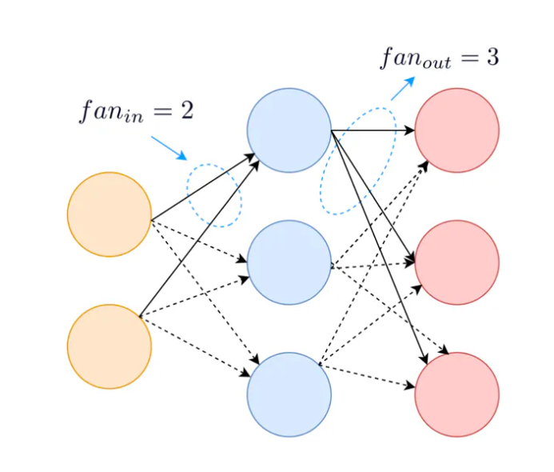
Terminology or Notations
fan_in = Number of input paths towards the neuron
fan_out = Number of output paths towards the neuron

Slide 16
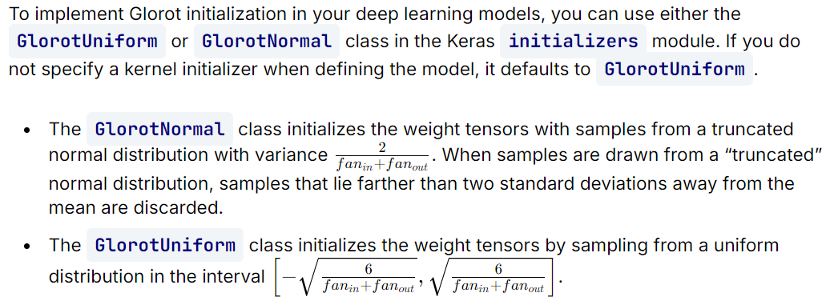
Xavier or Glorot Initialization
Best work on Tanh and Sigmoid Activation Function

Slide 17
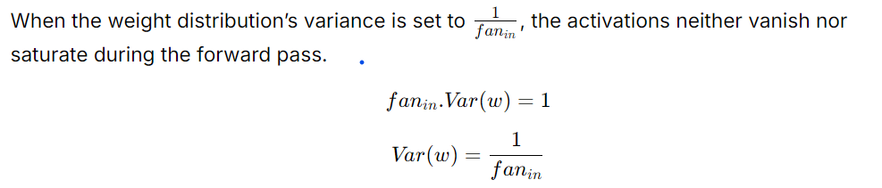
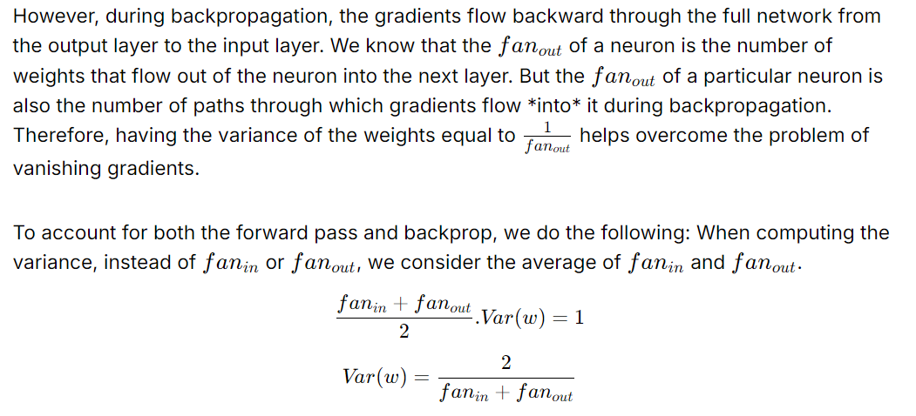

Slide 18
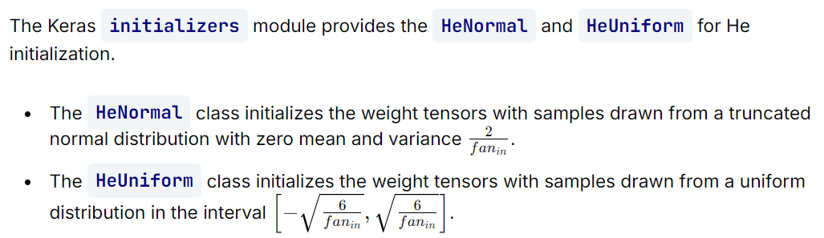
He Initialization
Best work on Relu Activation function

Slide 19
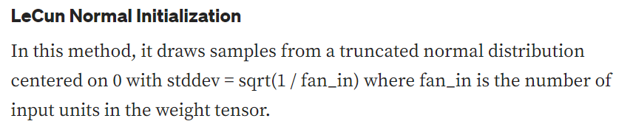
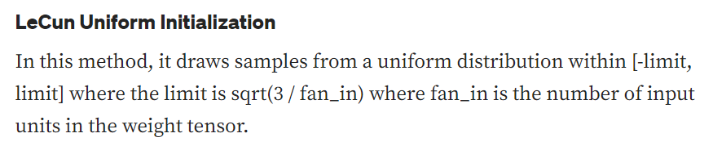
Lecun Initialization
Best work on hyperbolic tangent Activation Function.

Slide 20
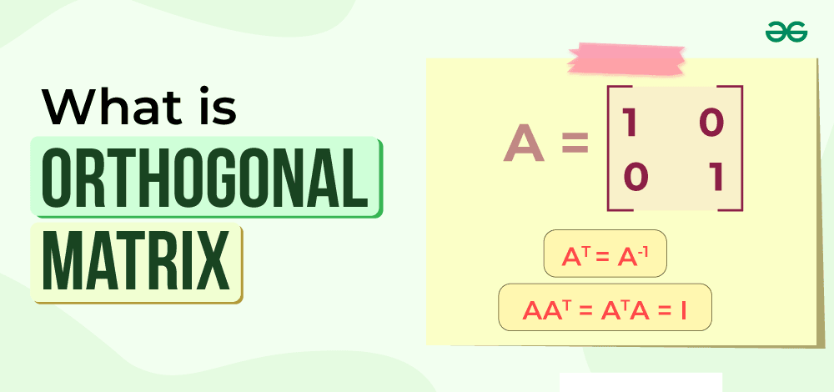
Orthogonal Initialization
It initializes the weight matrix with an orthogonal matrix.
This method helps to avoid the vanishing and exploding gradients problem that can occur in deep neural networks.
Orthogonal initialization can improve the stability and convergence of the network, especially for recurrent neural networks (RNNs) that have feedback loops and long-term dependencies.
However, orthogonal initialization may not be feasible for layers that have more outputs than inputs, or vice versa, as it requires the weight matrix to be square

Slide 21
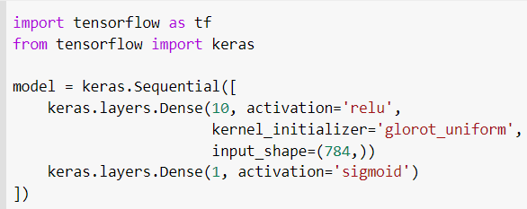
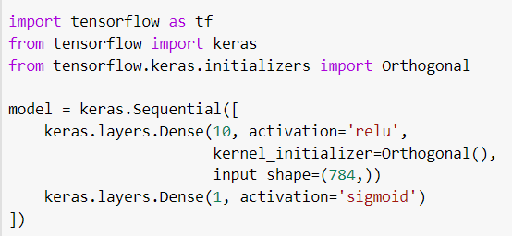
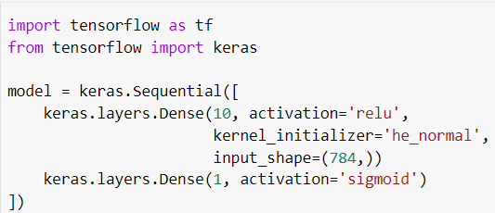
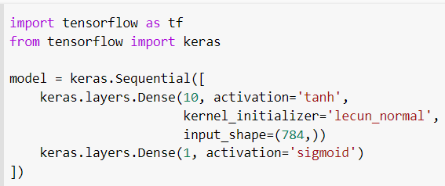
Codes

Slide 22
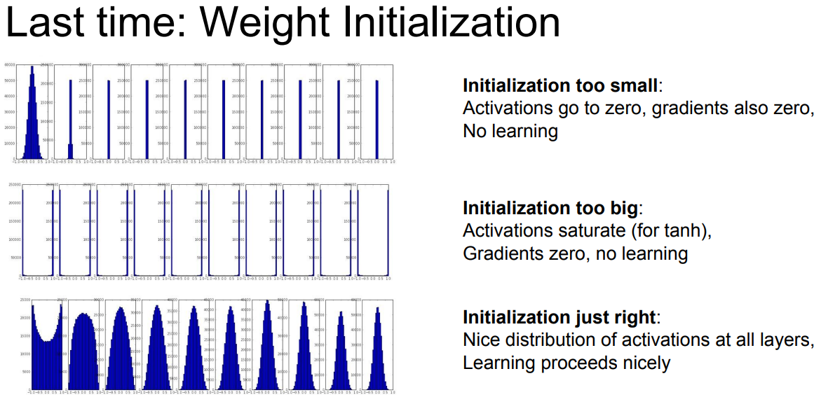

Slide 23
Reference
https://www.pinecone.io/learn/weight-initialization/
https://www.analyticsvidhya.com/blog/2021/05/how-to-initialize-weights-in-neural-networks/
https://medium.com/guidona-softpedia/weight-initialization-methods-in-neural-networks-a3e7a793cee5
https://www.geeksforgeeks.org/weight-initialization-techniques-for-deep-neural-networks/
https://www.deeplearning.ai/ai-notes/initialization/index.html
https://wandb.ai/sauravmaheshkar/initialization/reports/A-Gentle-Introduction-To-Weight-Initialization-for-Neural-Networks--Vmlldzo2ODExMTg

